Slide 1





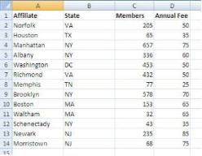

Database Modeling and Introduction to SQL
Creating E/R Diagrams with SQL Server Management Studio, Writing SQL Queries
D0ncho Minkov
Telerik Corporation
www.telerik.com

Slide 2


Table of Contents
Data Modeling – Principles
Data Types in SQL Server
Creating Databases in SQL Server
Creating Tables
Defining a Primary Key and Identity Columns
Creating Relationships between the Tables
One-to-many, Many-to-many, One-to-one
Naming conventions

Slide 3

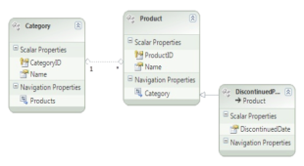

Table of Contents (2)
Nested SELECT Statements
Aggregating Data
Group Functions and GROUP BY
Microsoft SQL Server Functions
SQL Server Data Types
Data Definition Language (DDL)
Creating Tables in MS SQL Server
Naming Conventions

Slide 4

Table of Contents (3)
SQL and T-SQL Languages
The Telerik Academy Database Schema
Introducing the SELECT SQL Statement
Allowed Operators
The WHERE Clause
Sorting with ORDER BY
Selecting Data From Multiple Tables

Slide 5

Table of Contents (4)
Selecting Data From Multiple Tables
Natural Joins
Join with USING Clause
Inner Joins with ON Clause
Left, Right and Full Outer Joins
Cross Joins
Inserting Data
Updating Data
Deleting Data

Slide 6
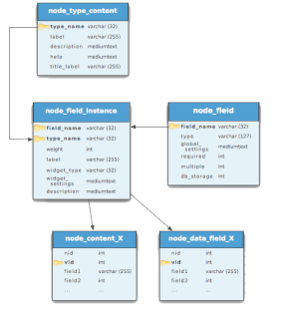


Relational Data Modeling
Fundamental Concepts

Slide 7
Steps in Database Design
Steps in the database design process:
Identification of the entities
Identification of the columns in the tables
Defining a primary key for each entity table
Identification and modeling of relationships
Multiplicity of relationships
Defining other constraints
Filling test data in the tables

Slide 8
Identification of Entities
Entity tables represent objects from the real world
Most often they are nouns in the specification
For example:
Entities: Student, Course, Town
We need to develop a system that stores information about students, which are trained in various courses. The courses are held in different towns. When registering a new student the following information is entered: name, faculty number, photo and date.

Slide 9


Identification of Columns
Columns in the tables are characteristics of the entities
They have name and type
For example students have:
Name (text)
Faculty number (number)
Photo (binary block)
Date of enlistment (date)

Slide 10
Identification of the Columns
Columns are clarifications for the entities in the text of the specification, for example:
Students have the following characteristics:
Name, faculty number, photo, date of enlistment and a list of courses they visit
We need to develop a system that stores information about students, which are trained in various courses. The courses are held in different towns. When registering a new student the following information is entered: name, faculty number, photo and date.

Slide 11
How to Choose a Primary Key?
Always define an additional column for the primary key
Don't use an existing column (for example SSN)
Must be an integer number
Must be declared as a primary key
Use identity to implement auto-increment
Put the primary key as a first column
Exceptions
Entities that have well known ID, e.g. countries (BG, DE, US) and currencies (USD, EUR, BGN)

Slide 12
Identification of Relationships
Relationships are dependencies between the entities:
"Students are trained in courses" – many-to-many relationship
"Courses are held in towns" – many-to-one (or many-to-many) relationship
We need to develop a system that stores information about students, which are trained in various courses. The courses are held in different towns. When registering a new student the following information is entered: name, faculty number, photo and date.

Slide 13
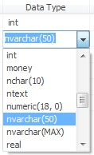

Data Types in SQL Server 2008

Slide 14
Data Types in SQL Server
Numeric
bit (1-bit), integer (32-bit), bigint (64-bit)
float, real, numeric(scale, precision)
money – for money (precise) operations
Strings
char(size) – fixed size string
varchar(size) – variable size string
nvarchar(size) – Unicode variable size string
text / ntext – text data block (unlimited size)

Slide 15
Data Types in SQL Server (2)
Binary data
varbinary(size) – a sequence of bits
image – a binary block up to 1 GB
Date and time
datetime – date and time starting from 1.1.1753 to 31.12. 9999, a precision of 1/300 sec.
smalldatetime – date and time (1-minute precision)

Slide 16

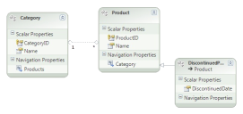
Data Types in SQL Server (3)
Other types
timestamp – automatically generated number whenever a change is made to the data row
uniqueidentifier – GUID identifier
xml – data in XML format

Slide 17


Data Types in SQL Server (4)
Nullable and NOT NULL types
All types in SQL Server may or may not allow NULL values
Primary key columns
Define the primary key
Identity columns
Automatically increased values when a new row is inserted (auto-increment values)
Used in combination with primary key

Slide 18

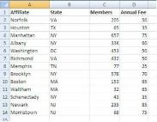



Database Modeling with SQL Server Management Studio
Creating Database

Slide 19
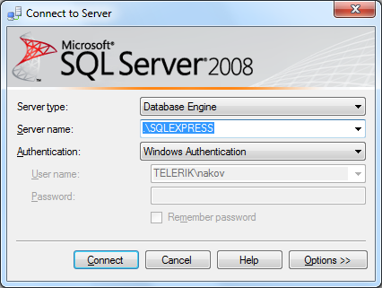
Connecting to SQL Server
When starting SSMS a window pops up
Usually it is enough to just click the "Connect" button without changing anything

Slide 20
Working with Object Explorer
Object Explorer is the main tool to use when working with the database and its objects
Enables us:
To create a new database
To create objects in the database (tables, stored procedures, relationships and others)
To change the properties of objects
To enter records into the tables

Slide 21
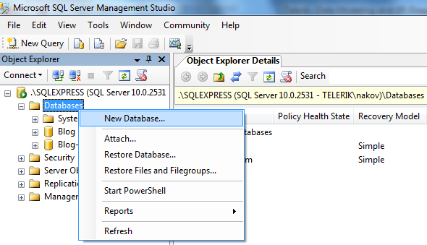
Creating a New Database
In Object Explorer we go to the "Databases" and choose "New Database…" from the context menu

Slide 22
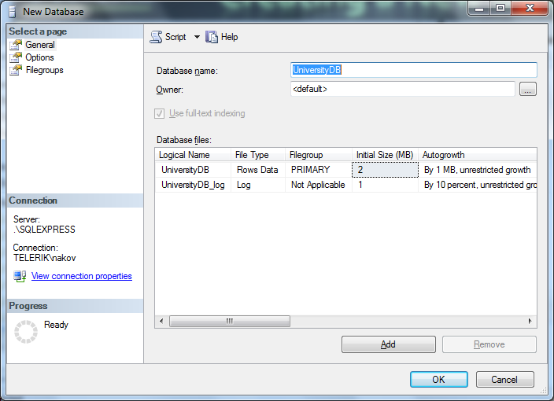
Creating a New Database (2)
In the "New Database" window enter the name of the new database and click [OK]

Slide 23
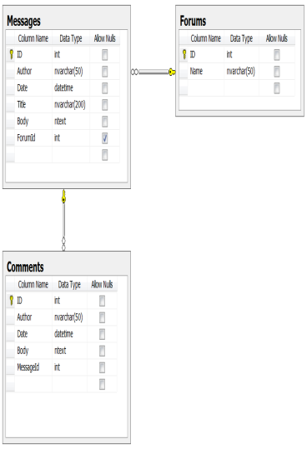

Database Modeling with SQL Server Management Studio
Creating E/R Diagrams

Slide 24
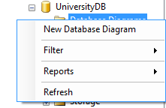
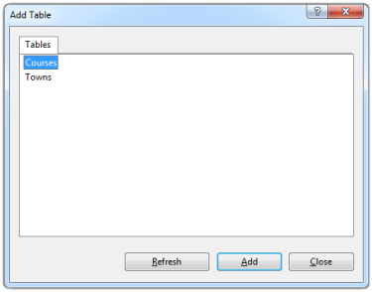
Creating an E/R diagram
In the "Database Diagrams" menu choose the "New Database Diagram"
We can choose from the existing tables, which we want to add to the diagram

Slide 25

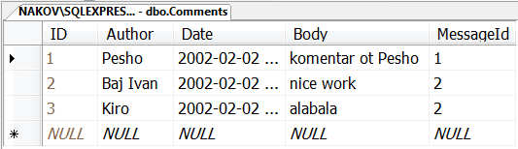

Database Modeling with SQL Server Management Studio
Creating Tables

Slide 26
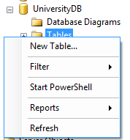
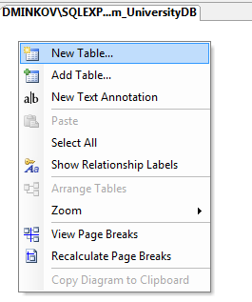
Creating Tables
If the database doesn't show immediately in Object Explorer perform "Refresh" [F5]
Creating new table:

Slide 27
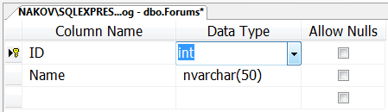
Creating Tables (2)
Enter table name and define the table columns (name and type):
Enter the name of the column here
Choose the data type of the column here
Choose whether NULLs are allowed

Slide 28
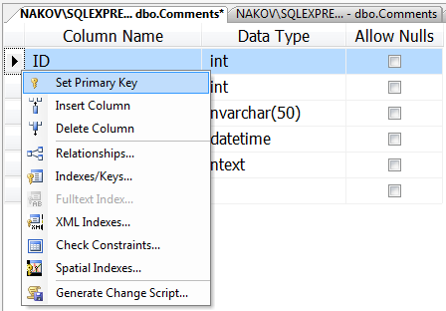
Creating Tables (3)
Defining a primary key
Right click on the column start and select "Set Primary Key"

Slide 29
Creating Tables (4)
Defining an identity columns
Identity means that the values in a certain column are auto generated (for int columns)
These values cannot be assigned manually
Identity Seed – the starting number from which the values in the column begin to increase.
Identity Increment – by how much each consecutive value is increased

Slide 30
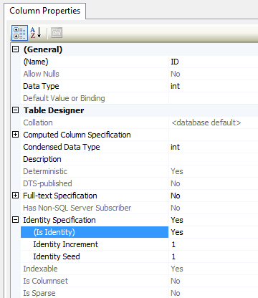
Creating Tables (5)
Setting an identity through the "Column Properties" window

Slide 31
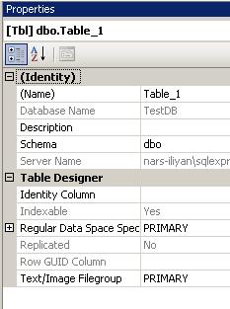
Creating Tables (6)
It is a good practice to set the name of the table at the time it is created
Use the "Properties" window
If it's not visible use "View" → "Properties Window" or press [F4]
Tablename

Slide 32
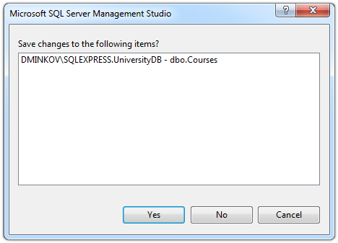
Creating Tables (7)
When closing the window for the table, SSMS asks whether to save the table
You can do it manually by choosing “Save Table” from the “File” menu or by pressing Ctrl + S

Slide 33
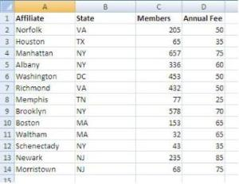


Database Modeling with SQL Server Management Studio
Creating Relationships between Tables

Slide 34
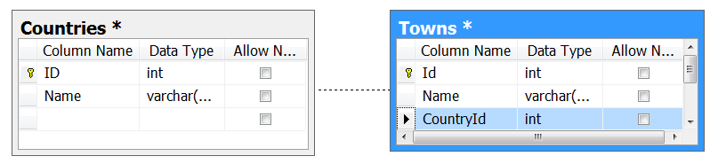
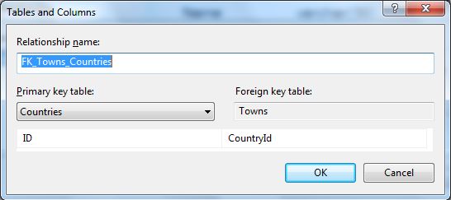
Creating Relationships
To create one-to-many relationship drag the foreign key column onto the other table
Drag from the child table to the parent table

Slide 35
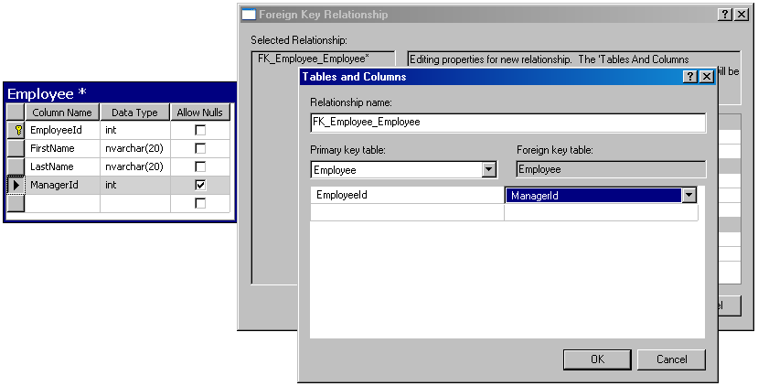
Self-Relationships
Self-relationship can be created by dragging a foreign key onto the same table

Slide 36
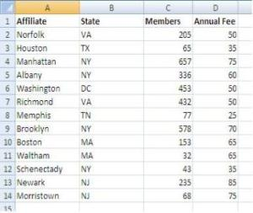



Database Modeling with SQL Server Management Studio
Naming Conventions

Slide 37
Naming Conventions
Tables
Each word is capitalized (Pascal Case)
In English, plural
Examples: Users, PhotoAlbums, Countries
Columns
In English, singular
Each word is capitalized (Pascal Case)
Avoid reserved words (e.g. key, int, date)
Examples: FirstName, OrderDate, Price

Slide 38
Naming Conventions (2)
Primary key
Use "Id" or name_of_the_table + "Id"
Example: in the Users table the PK column should be called Id or UserId
Foreign key
Use the name of the referenced table + "Id"
Example: in the Users table the foreign key column that references the Groups table should be named GroupId

Slide 39
Naming Conventions (3)
Relationship names (constraints)
In English, Pascal Case
"FK_" + first_table + "_" + second_table
For example: FK_Users_Groups
Index names
"IX_" + table + column
For example: IX_Users_UserName

Slide 40
Naming Conventions (4)
Unique key constraints names
"UK_" + table + column
For instance: UK_Users_UserName
Views names
V_ + name
Example: V_BGCompanies
Stored procedures names
usp_ + name
Example: usp_InsertCustomer(@name)

Slide 41
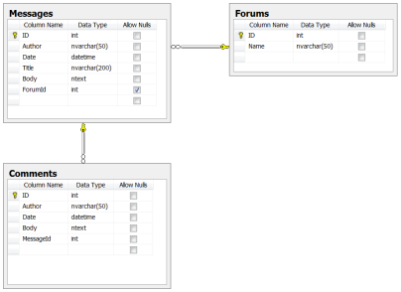

Database Modeling with SQL Server Management Studio
Live Demo

Slide 42


Relational Databases and SQL
The SQL Execution Model

Slide 43
Relational Databases and SQL
A relational database can be accessed and modified by executing SQL statements
SQL allows
Defining / modifying the database schema
Searching / modifying table data
A set of SQL commands are available for extracting subset of the table data
Most SQL commands return a single value or record set

Slide 44
Communicating with the DB
SQL statement is
sent to the DB server
SELECT Name
FROM Departments
Database
Name
Engineering
Sales
Marketing
…
The result is returned
(usually as a record set)

Slide 45
SQL Execution
SQL commands are executed through a database connection
DB connection is a channel between the client and the SQL server
DB connections take resources and should be closed when no longer used
Multiple clients can be connected to the SQL server at the same time
SQL commands can be executed in parallel
Transactions and isolation deal with concurrency

Slide 46


SQL and T-SQL
Introduction

Slide 47
What is SQL?
Structured Query Language (SQL)
Declarative language for query and manipulation of relational data
SQL consists of:
Data Manipulation Language (DML)
SELECT, INSERT, UPDATE, DELETE
Data Definition Language (DDL)
CREATE, DROP, ALTER
GRANT, REVOKE

Slide 48
SQL – Few Examples
SELECT FirstName, LastName, JobTitle FROM Employees
SELECT * FROM Projects WHERE StartDate = '1/1/2006'
INSERT INTO Projects(Name, StartDate)
VALUES('Introduction to SQL Course', '1/1/2006')
UPDATE Projects
SET EndDate = '8/31/2006'
WHERE StartDate = '1/1/2006'
DELETE FROM Projects
WHERE StartDate = '1/1/2006'

Slide 49
What is T-SQL?
T-SQL (Transact SQL) is an extension to the standard SQL language
T-SQL is the standard language used in MS SQL Server
Supports if statements, loops, exceptions
Constructions used in the high-level procedural programming languages
T-SQL is used for writing stored procedures, functions, triggers, etc.

Slide 50
T-SQL – Example
CREATE PROCEDURE EmpDump AS
DECLARE @EmpId INT, @EmpFName NVARCHAR(100),
@EmpLName NVARCHAR(100)
DECLARE emps CURSOR FOR
SELECT EmployeeID, FirstName, LastName FROM Employees
OPEN emps
FETCH NEXT FROM emps INTO @EmpId, @EmpFName, @EmpLName
WHILE (@@FETCH_STATUS = 0) BEGIN
PRINT CAST(@EmpId AS VARCHAR(10)) + ' '
+ @EmpFName + ' ' + @EmpLName
FETCH NEXT FROM emps INTO @EmpId, @EmpFName, @EmpLName
END
CLOSE emps
DEALLOCATE emps
GO

Slide 51

SQL Language
Introducing SELECT Statement

Slide 52
Capabilities of SQL SELECT
Projection
Take some of the columns
Selection
Take some of the rows
Table 1
Table 1
Join
Combine tables by
some column
Table 1
Table 2
Notes:
Capabilities of SQL SELECT Statements
A SELECT statement retrieves information from the database. Using a SELECT statement, you can do the following:
Projection: You can use the projection capability in SQL to choose the columns in a table that you want returned by your query. You can choose as few or as many columns of the table as you require.
Selection: You can use the selection capability in SQL to choose the rows in a table that you want returned by a query. You can use various criteria to restrict the rows that you see.
Joining: You can use the join capability in SQL to bring together data that is stored in different tables by creating a link between them. You learn more about joins in a later lesson.

Slide 53
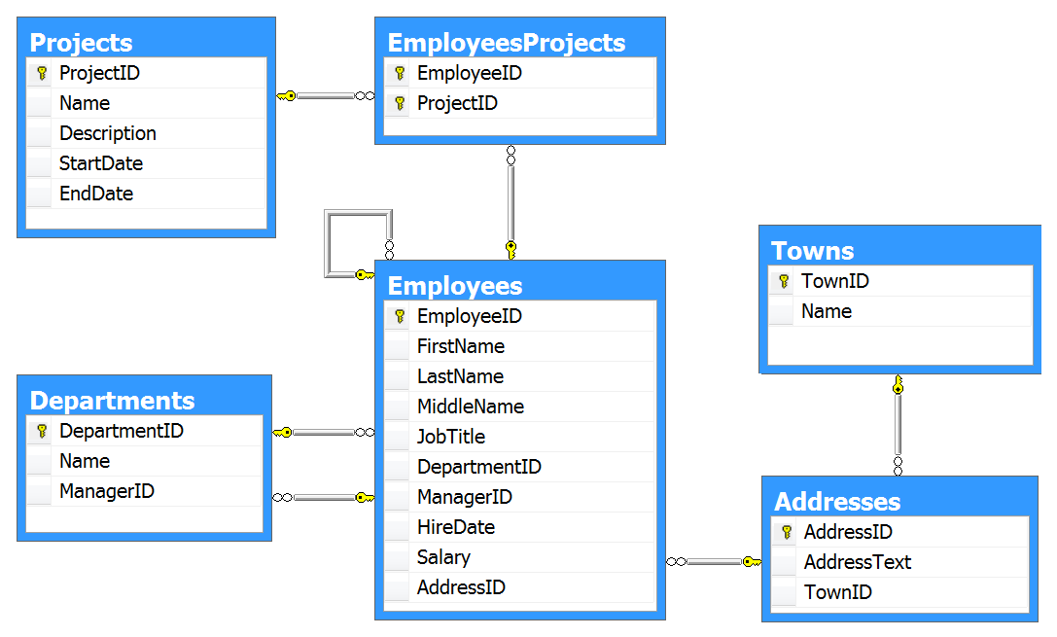
The Telerik Academy Database Schema in SQL Server

Slide 54

Basic SELECT Statement
SELECT identifies what columns
FROM identifies which table
SELECT *|{[DISTINCT] column|expression [alias],...}
FROM table
Notes:
Basic SELECT Statement
In its simplest form, a SELECT statement must include the following:
A SELECT clause, which specifies the columns to be displayed
A FROM clause, which specifies the table containing the columns listed in the SELECT clause
In the syntax:
SELECT is a list of one or more columns
* selects all columns
DISTINCT suppresses duplicates
column|expression selects the named column or the expression
alias gives selected columns different headings
FROM table specifies the table containing the columns
Note: Throughout this course, the words keyword, clause, and statement are used as follows:
A keyword refers to an individual SQL element. For example, SELECT and FROM are keywords.
A clause is a part of a SQL statement. For example, SELECT EmployeeId, LastName, ... is a clause.
A statement is a combination of two or more clauses. For example, SELECT * FROM employee is a SQL statement.

Slide 55
SELECT Example
Selecting all columns from departments
Selecting specific columns
SELECT * FROM Departments
DepartmentID | Name | ManagerID
1 | Engineering | 12
2 | Tool design | 4
3 | Sales | 273
… | … | …
SELECT
DepartmentID,
Name
FROM Departments
DepartmentID | Name
1 | Engineering
2 | Tool design
3 | Sales
Notes:
Selecting All Columns of All Rows
You can display all columns of data in a table by following the SELECT keyword with an asterisk (*). In the example on the slide, the department table contains five columns: DepartmentID, Name, GroupName, ModifiedDate and rowguid. The table contains 16 rows, one for each department.
You can also display all columns in the table by listing all the columns after the SELECT keyword. For example, the following SQL statement, like the example on the slide, displays all columns and all rows of the Departments table:
SELECT DepartmentID, Name, GroupName, ModifiedDate, rowguid
FROM department;
Selecting Specific Columns of All Rows
You can use the SELECT statement to display specific columns of the table by specifying the column names, separated by commas. The example on the slide displays all the department numbers and location numbers from the Departments table.
In the SELECT clause, specify the columns that you want, in the order in which you want them to appear in the output. For example, to display location before department number going from left to right, you use the following statement:
SELECT DepartmentID, Name
FROM Departments

Slide 56
Arithmetic Operations
Arithmetic operators are available:
+, -, *, /
Examples:
SELECT (2 + 3) * 4 --> returns 20
SELECT LastName, Salary, Salary + 300
FROM Employees
LastName | Salary | (No column name)
Gilbert | 12500,00 | 12800,00
Brown | 13500,00 | 13800,00
Tamburello | 43300,00 | 43600,00
Notes:
Using Arithmetic Operators
The example in the slide uses the addition operator to increase the salary for all employees by 300 and displays a new column in the output.
Note that the resultant calculated column for Salary+300 is not a new column in the Employees table; it is for display only.

Slide 57
The NULL Value
A NULL is a value that is unavailable, unassigned, unknown, or inapplicable
Not the same as zero or a blank space
Arithmetic expressions containing a NULL value are evaluated to NULL
SELECT LastName, ManagerID FROM Employees
LastName | ManagerID
Sánchez | NULL
Duffy | 300
Wang | 1
NULL is displayed as empty space or as NULL
Notes:
Null Values
If a row lacks the data value for a particular column, that value is said to be null, or to contain a null.
A null is a value that is unavailable, unassigned, unknown, or inapplicable. A null is not the same as zero or a space. Zero is a number, and a space is a character.
Columns of any data type can contain nulls. However, some constraints, NOT NULL and PRIMARY KEY, prevent nulls from being used in the column.
In the ManagerID column in the Employees table, notice that managers (like Sanchez) have no ManagerID.
If any column value in an arithmetic expression is null, the result is null. For example, if you attempt to perform division with zero, you get an error. However, if you divide a number by null, the result is a null or unknown.

Slide 58
Column Aliases
Aliases rename a column heading
Useful with calculations
Immediately follows the column name
There is an optional AS keyword
Double quotation marks if contains spaces
SELECT FirstName, LastName, Salary,
Salary*0.2 AS Bonus FROM Employees
FirstName | LastName | Salary | Bonus
Guy | Gilbert | 12500,00 | 2500.00000
Kevin | Brown | 13500,00 | 2700.00000
Notes:
Column Aliases
When displaying the result of a query, SQL Query Analyzer normally uses the name of the selected column as the column heading. For calculations the value usually is “(No column name)”. This heading is not descriptive and hence may be difficult to understand. You can change a column heading by using a column alias.
Specify the alias after the column in the SELECT list using a space as a separator. If the alias contains spaces or special characters (such as # or $), enclose the alias in double quotation marks (" ").

Slide 59
Concatenation Operator
Concatenates columns or character strings to other columns
Is represented by plus sign “+”
Creates a resultant column that is a character expression
SELECT FirstName + ' ' + LastName AS [Full Name],
EmployeeID as [No.] FROM Employees
Full Name | No.
Guy Gilbert | 1
Kevin Brown | 2
Roberto Tamburello | 3
Notes:
Concatenation Operator
You can link columns to other columns, arithmetic expressions, or constant values to create a character expression by using the concatenation operator (+). Columns on either side of the operator are combined to make a single output column.
In the example, FirstName and LastName are concatenated, and they are given the alias FullName. Notice that the employee first name and last name are combined to make a single output column.
The AS keyword before the alias name makes the SELECT clause easier to read.

Slide 60
Literal Character Strings
A literal is a character, a number, or a date included in the SELECT list
Date and character literal values must be enclosed within single quotation marks
Each character string is output once for each row returned
SELECT FirstName + '''s last name is ' +
LastName AS [Our Employees] FROM Employees
Our Employees
Guy's last name is Gilbert
Kevin's last name is Brown
Roberto's last name is Tamburello
Notes:
Literal Character Strings
A literal is a character, a number, or a date that is included in the SELECT list and that is not a column name or a column alias. It is printed for each row returned. Literal strings of free-format text can be included in the query result and are treated the same as a column in the SELECT list.
Date and character literals must be enclosed within single quotation marks (' '); number literals need not.
The example on the slide displays matching last names for employees’ first names. The column has the heading Employees.

Slide 61
Removing Duplicate Rows
The default display of queries is all rows, including duplicate rows
Eliminate duplicate rows by using the DISTINCT keyword in the SELECT clause
DepartmentID
7
7
2
...
SELECT DepartmentID
FROM Employees
DepartmentID
7
2
...
SELECT
DISTINCT DepartmentID
FROM Employees
Notes:
To eliminate duplicate rows in the result, include the DISTINCT keyword in the SELECT clause immediately after the SELECT keyword. In the example on the slide, the Employees table actually contains 290 rows but there are only 16 unique department numbers in the table.
You can specify multiple columns after the DISTINCT qualifier. The DISTINCT qualifier affects all the selected columns, and the result is every distinct combination of the columns.

Slide 62
Set Operations: UNION, INTERSECT and MINUS
UNION combines the results from several SELECT statements
The columns count and types should match
INTERSECT / EXCEPT perform logical intersection / difference between given two sets of records
SELECT FirstName AS Name
FROM Employees
UNION
SELECT LastName AS Name
FROM Employees
Name
A. Scott
Abbas
Abercrombie
...

Slide 63
Limiting the Rows Selected
Restrict the rows returned by using the WHERE clause:
More examples:
LastName | DepartmentID
Tamburello | 1
Erickson | 1
Goldberg | 1
... | ...
SELECT LastName, DepartmentID FROM Employees WHERE DepartmentID = 1
SELECT FirstName, LastName, DepartmentID FROM Employees WHERE LastName = 'Sullivan'
SELECT LastName, Salary FROM Employees
WHERE Salary <= 20000
Notes:
In the example, the SELECT statement retrieves the name and department number of all employees whose department is 1.
Character strings and dates in the WHERE clause must be enclosed in single quotation marks (''). Number constants, however, should not be enclosed in single quotation marks.

Slide 64
Other Comparison Conditions
Using BETWEEN operator to specify a range:
Using IN / NOT IN to specify a set of values:
Using LIKE operator to specify a pattern:
% means 0 or more chars; _ means one char
SELECT LastName, Salary FROM Employees
WHERE Salary BETWEEN 20000 AND 22000
SELECT FirstName, LastName, ManagerID FROM Employees WHERE ManagerID IN (109, 3, 16)
SELECT FirstName FROM Employees
WHERE FirstName LIKE 'S%'
Notes:
The BETWEEN Condition
You can display rows based on a range of values using the BETWEEN range condition. The range that you specify contains a lower limit and an upper limit.
The SELECT statement on the slide returns rows from the Employees table for any employee whose base rate is between 40 and 50.
Values specified with the BETWEEN condition are inclusive. You must specify the lower limit first.
The IN Condition
To test for values in a specified set of values, use the IN condition. The IN condition is also known as the membership condition.
The LIKE Condition
You may not always know the exact value to search for. You can select rows that match a character pattern by using the LIKE condition. The character pattern-matching operation is referred to as a wildcard search. Two symbols can be used to construct the search string.
Search conditions can contain either literal characters or numbers:
% denotes zero or many characters.
_ denotes one character.

Slide 65
Comparing with NULL
Checking for NULL value:
Attention: COLUMN=NULL is always false!
SELECT LastName, ManagerId FROM Employees
WHERE ManagerId IS NULL
SELECT LastName, ManagerId FROM Employees
WHERE ManagerId IS NOT NULL
SELECT LAST_NAME, MANAGER_ID FROM EMPLOYEES
WHERE MANAGER_ID = NULL
This is always false!
SELECT LAST_NAME, MANAGER_ID FROM EMPLOYEES
WHERE NULL = NULL
This is always false!
Notes:
Checking for NULL
Comparing NULL with any other value is always false!

Slide 66
Logical Operators and Brackets
Using NOT, OR and AND operators and brackets:
SELECT FirstName, LastName FROM Employees
WHERE Salary >= 20000 AND LastName LIKE 'C%'
SELECT LastName FROM Employees
WHERE ManagerID IS NOT NULL OR LastName LIKE '%so_'
SELECT LastName FROM Employees
WHERE NOT (ManagerID = 3 OR ManagerID = 4)
SELECT FirstName, LastName FROM Employees
WHERE
(ManagerID = 3 OR ManagerID = 4) AND
(Salary >= 20000 OR ManagerID IS NULL)
Notes:
Logical Conditions
A logical condition combines the result of two component conditions to produce a single result based on them or inverts the result of a single condition. A row is returned only if the overall result of the condition is true. Three logical operators are available in SQL:
AND
OR
NOT

Slide 67

Sorting with ORDER BY
Sort rows with the ORDER BY clause
ASC: ascending order, default
DESC: descending order
LastName | HireDate
Gilbert | 1998-07-31
Brown | 1999-02-26
Tamburello | 1999-12-12
SELECT LastName, HireDate FROM Employees ORDER BY HireDate
SELECT LastName, HireDate FROM Employees ORDER BY HireDate DESC
LastName | HireDate
Valdez | 2005-07-01
Tsoflias | 2005-07-01
Abbas | 2005-04-15
Notes:
The ORDER BY Clause
The order of rows returned in a query result is undefined. The ORDER BY clause can be used to sort the rows. If you use the ORDER BY clause, it must be the last clause of the SQL statement. You can specify an expression, or an alias, or column position as the sort condition.

Slide 68
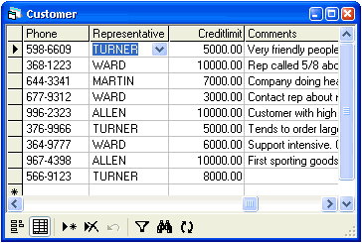

SQL Language
Selecting Data From Multiple Tables

Slide 69
Data from Multiple Tables
Sometimes you need data from more than one table:
LastName | DepartmentID
Duffy | 1
Abbas | 3
Galvin | 2
DepartmentID | Name
1 | Engineering
2 | Tool design
3 | Sales
LastName | DepartmentName
Duffy | Engineering
Galvin | Tool design
Abbas | Sales
Notes:
Data from Multiple Tables
Sometimes you need to use data from more than one table. In the slide example, the report displays data from two separate tables.
To produce the report, you need to link (join) the Employees and Departments tables and access data from both of them.

Slide 70
Cartesian Product
This will produce Cartesian product:
The result:
SELECT LastName, Name AS DepartmentName
FROM Employees, Departments
LastName | DepartmentName
Duffy | Document Control
Wang | Document Control
Sullivan | Document Control
Duffy | Engineering
Wang | Engineering
.. | ..

Slide 71
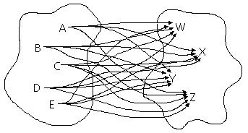

Cartesian Product (2)
A Cartesian product is formed when:
A join condition is omitted
A join condition is invalid
All rows in the first table are joined to all rows in the second table
To avoid a Cartesian product, always include a valid join condition

Slide 72



Types of Joins
Inner joins
Left, right and full outer joins
Cross joins
Notes:
These are SQL99 compliant joins

Slide 73
Inner Join with ON Clause
To specify arbitrary conditions or specify columns to join, the ON clause is used
Such JOIN is called also INNER JOIN
SELECT e.EmployeeID, e.LastName, e.DepartmentID,
d.DepartmentID, d.Name AS DepartmentName
FROM Employees e
INNER JOIN Departments d
ON e.DepartmentID = d.DepartmentID
EmployeeID | LastName | DepartmentID | DepartmentID | DepartmentName
1 | Gilbert | 7 | 7 | Production
2 | Brown | 4 | 4 | Marketing
3 | Tamburello | 1 | 1 | Engineering
Notes:
The ON Condition
Use the ON clause to specify a join condition. This lets you specify join conditions separate from any search or filter conditions in the WHERE clause.
The ON clause can also be used as follows to join columns that have different names:
SELECT e.LastName emp, m.LastName mgr
FROM employee e JOIN employee m
ON (e.ManagerID = m.EmployeeID);

Slide 74
Equijoins
Inner joins with join conditions pushed down to the WHERE clause
SELECT e.EmployeeID, e.LastName, e.DepartmentID,
d.DepartmentID, d.Name AS DepartmentName
FROM Employees e, Departments d
WHERE e.DepartmentID = d.DepartmentID
EmployeeID | LastName | Depart-mentID | Depart-mentID | Department-Name
1 | Gilbert | 7 | 7 | Production
2 | Brown | 4 | 4 | Marketing
3 | Tamburello | 1 | 1 | Engineering
Notes:
The ON Condition
Use the ON clause to specify a join condition. This lets you specify join conditions separate from any search or filter conditions in the WHERE clause.
The ON clause can also be used as follows to join columns that have different names:
SELECT e.LastName emp, m.LastName mgr
FROM employee e JOIN employee m
ON (e.ManagerID = m.EmployeeID);

Slide 75
INNER vs. OUTER Joins
Inner join
A join of two tables returning only rows matching the join condition
Left (or right) outer join
Returns the results of the inner join as well as unmatched rows from the left (or right) table
Full outer join
Returns the results of an inner join as well as the results of a left and right join

Slide 76
INNER JOIN
SELECT e.LastName EmpLastName,
m.EmployeeID MgrID, m.LastName MgrLastName
FROM Employees e INNER JOIN Employees m
ON e.ManagerID = m.EmployeeID
EmpLastName | MgrID | MgrLastName
Erickson | 3 | Tamburello
Goldberg | 3 | Tamburello
Duffy | 109 | Sánchez
Johnson | 185 | Hill
Higa | 185 | Hill
Ford | 185 | Hill
Maxwell | 21 | Krebs
... | ... | ...
Notes:
Example of LEFT OUTER JOIN : This query retrieves all rows in the left Employees (employees) table, even if there is no match in the right Employees (managers) table.
Example of RIGHT OUTER JOIN : This query retrieves all rows in the right Employees (managers) table, even if there is no match in the left Employees (employees) table.
Example of FULL OUTER JOIN : This query retrieves all rows in the left Employees (employees) table, even if there is no match in the right Employees (managers) table. It also retrieves all rows in the right Employees (managers) table, even if there is no match in the left Employees (employees) table.

Slide 77
LEFT OUTER JOIN
SELECT e.LastName EmpLastName,
m.EmployeeID MgrID, m.LastName MgrLastName
FROM Employees e LEFT OUTER JOIN Employees m
ON e.ManagerID = m.EmployeeID
EmpLastName | MgrID | MgrLastName
Sánchez | NULL | NULL
Benshoof | 6 | Bradley
Miller | 14 | Maxwell
Okelberry | 16 | Brown
Hill | 25 | Mu
Frum | 184 | Richins
Culbertson | 30 | Barreto de Mattos
... | ... | ...
Notes:
Example of LEFT OUTER JOIN : This query retrieves all rows in the left Employees (employees) table, even if there is no match in the right Employees (managers) table.
Example of RIGHT OUTER JOIN : This query retrieves all rows in the right Employees (managers) table, even if there is no match in the left Employees (employees) table.
Example of FULL OUTER JOIN : This query retrieves all rows in the left Employees (employees) table, even if there is no match in the right Employees (managers) table. It also retrieves all rows in the right Employees (managers) table, even if there is no match in the left Employees (employees) table.

Slide 78
RIGHT OUTER JOIN
SELECT e.LastName EmpLastName,
m.EmployeeID MgrID, m.LastName MgrLastName
FROM Employees e RIGHT OUTER JOIN Employees m
ON e.ManagerID = m.EmployeeID
EmpLastName | MgrID | MgrLastName
Lertpiriyasuwat | 38 | Liu
NULL | 39 | Hines
NULL | 40 | McKay
Berglund | 41 | Wu
Koenigsbauer | 123 | Hay
NULL | 124 | Zabokritski
NULL | 125 | Decker
... | ... | ...
Notes:
Example of LEFT OUTER JOIN : This query retrieves all rows in the left Employees (employees) table, even if there is no match in the right Employees (managers) table.
Example of RIGHT OUTER JOIN : This query retrieves all rows in the right Employees (managers) table, even if there is no match in the left Employees (employees) table.
Example of FULL OUTER JOIN : This query retrieves all rows in the left Employees (employees) table, even if there is no match in the right Employees (managers) table. It also retrieves all rows in the right Employees (managers) table, even if there is no match in the left Employees (employees) table.

Slide 79
FULL OUTER JOIN
SELECT e.LastName EmpLastName,
m.EmployeeID MgrID, m.LastName MgrLastName
FROM employee e FULL OUTER JOIN employee m
ON e.ManagerID = m.EmployeeID
EmpLastName | MgrID | MgrLastName
Sanchez | NULL | NULL
… | … | …
Cracium | 3 | Tamburello
Gilbert | 16 | Brown
… | … | …
NULL | 17 | Hartwig
NULL | 1 | Gilbert
… | … | …
Notes:
Example of LEFT OUTER JOIN : This query retrieves all rows in the left Employees (employees) table, even if there is no match in the right Employees (managers) table.
Example of RIGHT OUTER JOIN : This query retrieves all rows in the right Employees (managers) table, even if there is no match in the left Employees (employees) table.
Example of FULL OUTER JOIN : This query retrieves all rows in the left Employees (employees) table, even if there is no match in the right Employees (managers) table. It also retrieves all rows in the right Employees (managers) table, even if there is no match in the left Employees (employees) table.

Slide 80
Three-Way Joins
A three-way join is a join of three tables
SELECT e.FirstName, e.LastName,
t.Name as Towns, a.AddressText
FROM Employees e
JOIN Addresses a
ON e.AddressID = a.AddressID
JOIN Towns t
ON a.TownID = t.TownID
FirstName | LastName | Towns | AddressText
Guy | Gilbert | Monroe | 7726 Driftwood Drive
Kevin | Brown | Everett | 2294 West 39th St.
Roberto | Tamburello | Redmond | 8000 Crane Court
... | ... | ... | ...
Notes:
Three-Way Joins
A three-way join is a join of three tables. In SQL: 1999 compliant syntax, joins are performed from left to right so the first join to be performed is Employees JOIN ADDRESS. The first join condition can reference columns in Employees and ADDRESS but cannot reference columns in STATEPROVINCE. The second join condition can reference columns from all three tables.
This can also be written as a three-way equijoin:
SELECT e.LastName, a.City, sp.Name SPName
FROM employee e, address a, stateprovince sp
WHERE e.AddressID = a.AddressID
AND a.StateProvinceID = sp.StateProvinceID

Slide 81
Self-Join
Self-join means to join a table to itself
Always used with table aliases
SELECT e.FirstName + ' ' + e.LastName +
' is managed by ' + m.LastName as Message
FROM Employees e JOIN Employees m
ON (e.ManagerId = m.EmployeeId)
Message
Ovidiu Cracium is managed by Tamburello
Michael Sullivan is managed by Tamburello
Sharon Salavaria is managed by Tamburello
Dylan Miller is managed by Tamburello
…

Slide 82
Cross Join
The CROSS JOIN clause produces the cross-product of two tables
Same as a Cartesian product
Not often used
SELECT LastName [Last Name], Name [Dept Name]
FROM Employees CROSS JOIN Departments
Last Name | Dept Name
Duffy | Document Control
Wang | Document Control
Duffy | Engineering
Wang | Engineering
… | …
Notes:
Creating Cross Joins
The example on the slide gives the same results as the following:
SELECT LastName, Name DepartmentName
FROM employee, department;

Slide 83
Additional Conditions
You can apply additional conditions in the WHERE clause:
SELECT e.EmployeeID, e.LastName, e.DepartmentID,
d.DepartmentID, d.Name AS DepartmentName
FROM Employees e
INNER JOIN Departments d
ON e.DepartmentID = d.DepartmentID
WHERE d.Name = 'Sales'
EmployeeID | LastName | Depart-mentID | Depart-mentID | Department-Name
268 | Jiang | 3 | 3 | Sales
273 | Welcker | 3 | 3 | Sales
275 | Blythe | 3 | 3 | Sales
Notes:
The example shown performs a join on the Employees and Departments tables, and, in addition, displays only employees within the Sales depatment.

Slide 84
Complex Join Conditions
Joins can use any Boolean expression in the ON clause:
SELECT e.FirstName, e.LastName, d.Name as DeptName
FROM Employees e
INNER JOIN Departments d
ON (e.DepartmentId = d.DepartmentId
AND e.HireDate > '1/1/1999'
AND d.Name IN ('Sales', 'Finance'))
FirstName | LastName | DeptName
Deborah | Poe | Finance
Wendy | Kahn | Finance
… | … | …

Slide 85



SQL Language
Inserting Data in Tables

Slide 86
Inserting Data
INSERT command
INSERT INTO <table> VALUES (<values>)
INSERT INTO <table>(<columns>) VALUES (<values>)
INSERT INTO <table> SELECT <values>
INSERT INTO EmployeesProjects
VALUES (229, 25)
INSERT INTO Projects(Name, StartDate)
VALUES ('New project', GETDATE())
INSERT INTO Projects(Name, StartDate)
SELECT Name + ' Restructuring', GETDATE()
FROM Departments

Slide 87

SQL Language
Updating Data in Tables

Slide 88


Updating Joined Tables
We can update tables based on condition from joined tables
UPDATE Employees
SET JobTitle = 'Senior ' + JobTitle
FROM Employees e
JOIN Departments d
ON e.DepartmentID = d.DepartmentID
WHERE d.Name = 'Sales'

Slide 89
Updating Data
UPDATE command
UPDATE <table> SET <column=expression> WHERE <condition>
Note: Don't forget the WHERE clause!
UPDATE Employees
SET LastName = 'Brown'
WHERE EmployeeID = 1
UPDATE Employees
SET Salary = Salary * 1.10,
JobTitle = 'Senior ' + JobTitle
WHERE DepartmentID = 3

Slide 90

SQL Language
Deleting Data From Tables

Slide 91
Deleting Data
Deleting rows from a table
DELETE FROM <table> WHERE <condition>
Note: Don’t forget the WHERE clause!
Delete all rows from a table at once
TRUNCATE TABLE <table>
DELETE FROM Employees WHERE EmployeeID = 1
DELETE FROM Employees WHERE LastName LIKE 'S%'
TRUNCATE TABLE Users

Slide 92

Deleting from Joined Tables
We can delete records from tables based on condition from joined tables
DELETE FROM Employees
FROM Employees e
JOIN Departments d
ON e.DepartmentID = d.DepartmentID
WHERE d.Name = 'Sales'

Slide 93


WTF?

Slide 94



SQL Language
SQL
SQL
Nested SELECT Statements
SQL
SQL

Slide 95
Nested SELECT Statements
SELECT statements can be nested in the where clause
Note: always prefer joins to nested SELECT statements for better performance
SELECT FirstName, LastName, Salary
FROM Employees
WHERE Salary =
(SELECT MAX(Salary) FROM Employees)
SELECT FirstName, LastName, DepartmentID, Salary
FROM Employees
WHERE DepartmentID IN
(SELECT DepartmentID FROM Departments
WHERE Name='Sales')

Slide 96
Nested SELECT Statements with Table Aliases
Tables from the main SELECT can be referred in the nested SELECT by aliases
Example:
Find the maximal salary for each department and the name of the employee that gets it
SELECT FirstName, LastName, DepartmentID, Salary
FROM Employees e
WHERE Salary =
(SELECT MAX(Salary) FROM Employees
WHERE DepartmentID = e.DepartmentID)
ORDER BY DepartmentID

Slide 97
Using the EXISTS Operator
Using the EXISTS operator in SELECT statements
Find all employees with managers from the first department
SELECT FirstName, LastName, EmployeeID, ManagerID
FROM Employees e
WHERE EXISTS
(SELECT EmployeeID
FROM Employees m
WHERE m.EmployeeID = e.ManagerID
AND m.DepartmentID = 1)

Slide 98



SQL Language
Aggregating Data with Group Functions

Slide 99

Group Functions
Group functions operate over sets of rows to give one single result (per group)
EmployeeID | Salary
1 | 12500,00
2 | 13500,00
3 | 43300,00
4 | 29800,00
5 | 25000,00
... | ...
MAX(Salary)
125500,00

Slide 100
Group Functions in SQL
COUNT(*) – count of the selected rows
SUM(column) – sum of the values in given column from the selected rows
AVG(column) – average of the values in given column
MAX(column) – the maximal value in given column
MIN(column) – the minimal value in given column
Notes:
Group functions operate on sets of rows to give one result per group. These sets may be the whole table or the table split into groups.
Each of the functions accepts an argument. The following table identifies the options that you can use in the syntax:

Slide 101
AVG() and SUM() Functions
You can use AVG() and SUM() only for numeric data types
SELECT
AVG(Salary) [Average Salary],
MAX(Salary) [Max Salary],
MIN(Salary) [Min Salary],
SUM(Salary) [Salary Sum]
FROM Employees
WHERE JobTitle = 'Design Engineer'
Average Salary | Max Salary | Min Salary | Salary Sum
32700.00 | 32700.00 | 32700.00 | 98100.00
Notes:
The example on the slide displays the average, highest, lowest, and sum of vacation hours for all sales representatives.

Slide 102
MIN() and MAX() Functions
You can use MIN() and MAX() for almost any data type (int, datetime, varchar, ...)
Displaying the first and last employee's name in alphabetical order:
SELECT MIN(HireDate) MinHD, MAX(HireDate) MaxHD
FROM Employees
MinHD | MaxHD
1996-07-31 | 2003-06-03
SELECT MIN(LastName), MAX(LastName)
FROM Employees

Slide 103
The COUNT(…) Function
COUNT(*) returns the number of rows in the result record set
COUNT(expr) returns the number of rows with non-null values for the expr
SELECT COUNT(*) Cnt FROM Employees
WHERE DepartmentID = 3
Cnt
18
SELECT COUNT(ManagerID) MgrCount,
COUNT(*) AllCount
FROM Employees
WHERE DepartmentID = 16
MgrCount | AllCount
1 | 2
Notes:
The COUNT Function
The COUNT function has three formats:
COUNT(*)
COUNT(expr)
COUNT(DISTINCT expr)
COUNT(*) returns the number of rows in a table that satisfy the criteria of the SELECT statement, including duplicate rows and rows containing null values in any of the columns. If a WHERE clause is included in the SELECT statement, COUNT(*) returns the number of rows that satisfies the condition in the WHERE clause.
In contrast, COUNT(expr) returns the number of non-null values in the column identified by expr.
COUNT(DISTINCT expr) returns the number of unique, non-null values in the column identified by expr.
The slide example displays the number of employees in department 3 (Sales).

Slide 104
Group Functions and NULLs
Group functions ignore NULL values in the target column
If each NULL value in the ManagerID column were considered as 0 in the calculation, the result would be 106
SELECT AVG(ManagerID) Avg,
SUM(ManagerID) / COUNT(*) AvgAll
FROM Employees
Avg | AvgAll
108 | 106

Slide 105
Group Functions in Nested Queries
Find the earliest hired employee for each department
SELECT e.FirstName, e.LastName, e.HireDate, d.Name
FROM Employees e
JOIN Departments d
ON e.DepartmentID = d.DepartmentID
WHERE e.HireDate =
(SELECT MIN(HireDate) FROM Employees
WHERE DepartmentID = d.DepartmentID)
FirstName | LastName | HireDate | Name
Guy | Gilbert | 1998-07-31 00:00:00 | Production
Kevin | Brown | 1999-02-26 00:00:00 | Marketing
Roberto | Tamburello | 1999-12-12 00:00:00 | Engineering

Slide 106



SQL Language
Group Functions and the
GROUP BY Statement

Slide 107
Creating Groups of Data
Employees
DepartmentID | Salary
12 | 10300
12 | 16800
12 | 16800
12 | 10300
12 | 17800
2 | 28800
2 | 25000
2 | 29800
2 | 25000
16 | 125500
16 | 60100
... | ...
72000
Depart-mentID | SUM (Salary)
12 | 72000
2 | 108600
16 | 185600
... | ...
108600
185600

Slide 108
The GROUP BY Statement
We can divide rows in a table into smaller groups by using the GROUP BY clause
The SELECT + GROUP BY syntax:
The <group_by_expression> is a list of columns
SELECT <columns>, <group_function(column)>
FROM <table>
[WHERE <condition>]
[GROUP BY <group_by_expression> ]
[HAVING <filtering_expression>]
[ORDER BY <columns>

Slide 109
The GROUP BY Statement (2)
Example of grouping data:
The GROUP BY column is not necessary needed to be in the SELECT list
SELECT DepartmentID, SUM(Salary) as SalariesCost
FROM Employees
GROUP BY DepartmentID
DepartmentID | SalariesCost
12 | 72000
2 | 108600
16 | 185600
... | ...

Slide 110

Grouping by Several Columns
Depart-mentID | JobTitle | Salary
11 | Network Manager | 39700
11 | Network Administrator | 32500
11 | Network Administrator | 32500
11 | Database Administrator | 38500
11 | Database Administrator | 38500
10 | Accountant | 26400
10 | Accountant | 26400
10 | Finance Manager | 43300
... | ... | ...
39700
DepartmentID | JobTitle | Salary
11 | Network Manager | 39700
11 | Network Administrator | 65000
11 | Database Administrator | 77000
10 | Accountant | 52800
10 | Finance Manager | 43300
... | ... | ...
65000
77000
52800
43300

Slide 111
Grouping by Several Columns – Example
Example of grouping data by several columns:
SELECT DepartmentID, JobTitle,
SUM(Salary) as Salaries, COUNT(*) as Count
FROM Employees
GROUP BY DepartmentID, JobTitle
DepartmentID | JobTitle | Salaries | Count
2 | Senior Tool Designer | 58600 | 2
2 | Tool Designer | 50000 | 2
7 | Production Supervisor | 525000 | 21
7 | Production Technician | 1926000 | 157
... | ... | ... | ...

Slide 112

Illegal Use of Group Functions
This SELECT statement is illegal:
Can not combine columns with groups functions unless when using GROUP BY
This SELECT statement is also illegal
Can not use WHERE for group functions
SELECT DepartmentID, COUNT(LastName)
FROM Employees
SELECT DepartmentID, AVG(Salary)
FROM Employees
WHERE AVG(Salary) > 30
GROUP BY DepartmentID

Slide 113
Restrictions for Grouping
When using groups we can select only columns listed in the GROUP BY and grouping functions over the other columns
Can not select columns not listed in the GROUP BY clause
It is allowed to apply group functions over the columns in the GROUP BY clause, but has no sense
SELECT DepartmentID, JobTitle,
SUM(Salary) AS Cost, MIN(HireDate) as StartDate
FROM Employees
GROUP BY DepartmentID, JobTitle

Slide 114
Using GROUP BY with HAVING Clause
HAVING works like WHERE but is used for the grouping functions
SELECT DepartmentID, COUNT(EmployeeID) as
Count, AVG(Salary) AverageSalary
FROM Employees
GROUP BY DepartmentID
HAVING COUNT(EmployeeID) BETWEEN 3 AND 5
DepartmentID | Count | AverageSalary
2 | 4 | 27150
12 | 5 | 14400
… | … | …

Slide 115
Using Grouping Functions and Table Joins
Grouping function can be applied on columns from joined tables
SELECT COUNT(*) AS EmpCount, d.Name AS DeptName
FROM Employees e JOIN Departments d
ON e.DepartmentID = d.DepartmentID
WHERE e.HireDate BETWEEN '1999-2-1' AND '2002-12-31'
GROUP BY d.Name
HAVING COUNT(*) > 5
ORDER BY EmpCount DESC
EmpCount | DeptName
95 | Production
8 | Finance
8 | Information Services

Slide 116

SQL Language
SQL Server Functions

Slide 117


Standard Functions in Microsoft SQL Server
Single-row functions
String functions
Mathematical functions
Date functions
Conversion functions
Multiple-row functions
Aggregate functions
SQL

Slide 118
COALESCE() Function
COALESCE(<value>,<default_value>) – converts NULL values to given default value
SELECT Name AS [Projects Name],
COALESCE(EndDate, GETDATE()) AS [End Date]
FROM Projects
Projects Name | End Date
Classic Vest | 2006-07-02 08:19:43.983
Cycling Cap | 2003-06-01 00:00:00.000
Full-Finger Gloves | 2003-06-01 00:00:00.000
Half-Finger Gloves | 2003-06-01 00:00:00.000
HL Mountain Frame | 2003-06-01 00:00:00.000
... | ...

Slide 119
String Functions
Changing the casing – LOWER, UPPER
Manipulating characters – SUBSTRING, LEN, LEFT, RIGHT, LTRIM, REPLACE
SELECT LastName, LEN(LastName) AS LastNameLen,
UPPER(LastName) AS UpperLastName
FROM Employees
WHERE RIGHT(LastName, 3) = 'son'
LastName | LastNameLen | UpperLastName
Erickson | 8 | ERICKSON
Johnson | 7 | JOHNSON
Munson | 6 | MUNSON
... | ... | ...

Slide 120

Other Functions
Mathematical Functions – ROUND, FLOOR, POWER, ABS, SQRT, …
Date Functions – GETDATE, DATEADD, DAY, MONTH, YEAR, …
Conversion Functions – CONVERT, CAST
SELECT FLOOR(3.14) → 3
SELECT ROUND(5.86, 0) → 6.00
SELECT CONVERT(DATETIME, '20051231', 112)
→ 2005-12-31 00:00:00.000
-- 112 is the ISO formatting style YYYYMMDD
Notes:
Using CONVERT:
CONVERT ( data_type [ ( length ) ] , expression [ , style ] )
The style argument value of 112 represents the ISO data format: yymmdd

Slide 121
Combining Functions
We can combine functions to achieve more complex behavior
SELECT Name AS [Projects Name],
COALESCE(CONVERT(nvarchar(50), EndDate),
'Not Finished') AS [Date Finished]
FROM Projects
Projects Name | Date Finished
HL Mountain Front Wheel | Jun 1 2003 12:00AM
LL Touring Handlebars | Not Finished
HL Touring Handlebars | Not Finished
LL Road Front Wheel | Jun 1 2003 12:00AM
... | ...

Slide 122




SQL Language
Data Definition Language (DDL)

Slide 123


Data Definition Language
DDL commands for defining / editing objects
CREATE
ALTER
DROP
Data Control Language (DCL) for managing access permissions
GRANT
REVOKE
DENY

Slide 124
Creating Database Objects
CREATE command
CREATE TABLE <name> (<field_definitions>)
CREATE VIEW <name> AS <select>
CREATE <object> <definition>
CREATE TABLE Persons (
PersonID int IDENTITY,
Name nvarchar(100) NOT NULL,
CONSTRAINT PK_Persons PRIMARY KEY(PersonID)
)
GO
CREATE VIEW [First 10 Persons] AS
SELECT TOP 10 Name FROM Persons

Slide 125
Creating Objects – More Examples
CREATE TABLE Countries (
CountryID int IDENTITY,
Name nvarchar(100) NOT NULL,
CONSTRAINT PK_Countries PRIMARY KEY(CountryID)
)
GO
CREATE TABLE Cities (
CityID int IDENTITY,
Name nvarchar(100) NOT NULL,
CountryID int NOT NULL,
CONSTRAINT PK_Cities PRIMARY KEY(CityID)
)

Slide 126
Modifying Database Objects
ALTER command
ALTER TABLE <name> <command>
ALTER <object> <command>
-- Add a foreign key constraint Cities --> Country
ALTER TABLE Cities
ADD CONSTRAINT FK_Cities_Countries
FOREIGN KEY (CountryID)
REFERENCES Countries(CountryID)
-- Add column Population to the table Country
ALTER TABLE Countries ADD COLUMN Population int
-- Remove column Population from the table Country
ALTER TABLE Countries DROP COLUMN Population

Slide 127
Deleting Database Objects
DROP command
DROP TABLE <name>
DROP TRIGGER <name>
DROP INDEX <name>
DROP <object>
DROP TABLE Persons
ALTER TABLE Cities
DROP CONSTRAINT FK_Cities_Countries

Slide 128
Managing Access Permissions
GRANT command
Example:
REVOKE command
Example:
GRANT <persmission> ON <object> TO <role>
GRANT SELECT ON Persons TO public
REVOKE <persmission> ON <object> FROM <role>
REVOKE SELECT ON Employees FROM public

Slide 129

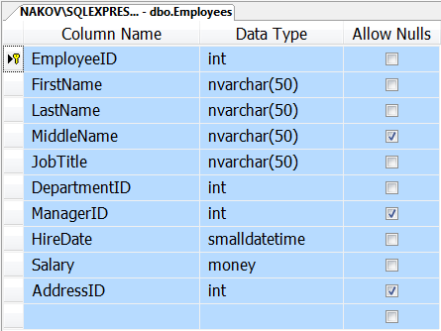

Creating Tables in SQL Server
Best Practices

Slide 130
Creating Tables in SQL Server
Creating new table:
Define the table name
Should have good name
Define the columns and their types
Use proper data type
Define the table primary key
Use IDENTITY for enabling auto increment of the primary key
Define foreign/keys and constraints

Slide 131
Creating Tables in SQL Server – Examples
CREATE TABLE Groups (
GroupID int IDENTITY,
Name nvarchar(100) NOT NULL,
CONSTRAINT PK_Groups PRIMARY KEY(GroupID)
)
CREATE TABLE Users (
UserID int IDENTITY,
UserName nvarchar(100) NOT NULL,
GroupID int NOT NULL,
CONSTRAINT PK_Users PRIMARY KEY(UserID),
CONSTRAINT FK_Users_Groups FOREIGN KEY(GroupID)
REFERENCES Groups(GroupID)
)

Slide 132




Transactions
Begin / Commit / Rollback Transactions in SQL Server

Slide 133
What Is Concurrency Control?
Pessimistic locking (default in SQL Server)
Locks table data at each data is modification
Concurrent users are blocked until the lock is released
Optimistic locking (default in Oracle)
No locks are performed when data is being read or changed
Concurrent users don’t see the changes until they are committed / rolled-back
Supported with SNAPSHOT isolation in SQL Server

Slide 134
Transactions
Transactions start by executing BEGIN TRANSACTION (or just BEGIN TRAN)
Use COMMIT to confirm changes and finish the transaction
Use ROLLBACK to cancel changes and abort the transaction
Example:
BEGIN TRAN
DELETE FROM EmployeesProjects;
DELETE FROM Projects;
ROLLBACK TRAN

Slide 135
The Implicit Transactions Option
What is implicit transactions mode?
Automatically start a new transaction after each commit or rollback
Nested transactions are not allowed
Transaction must be explicitly completed with COMMIT or ROLLBACK TRANSACTION
By default, IMPLICIT_TRANSACITONS setting is switched off
SET IMPLICIT_TRANSACTIONS ON

Slide 136



Introduction to SQL (Part II)
Questions?

Slide 137
Exercises
Write a SQL query to find the names and salaries of the employees that take the minimal salary in the company. Use a nested SELECT statement.
Write a SQL query to find the names and salaries of the employees that have a salary that is up to 10% higher than the minimal salary for the company.
Write a SQL query to find the full name, salary and department of the employees that take the minimal salary in their department. Use a nested SELECT statement.

Slide 138
Exercises (2)
Write a SQL query to find the average salary in the department #1.
Write a SQL query to find the average salary in the "Sales" department.
Write a SQL query to find the number of employees in the "Sales" department.
Write a SQL query to find the number of all employees that have manager.
Write a SQL query to find the number of all employees that have no manager.
Write a SQL query to find all departments and the average salary for each of them.

Slide 139
Exercises (3)
Write a SQL query to find the count of all employees in each department and for each town.
Write a SQL query to find all managers that have exactly 5 employees. Display their first name and last name.
Write a SQL query to find all employees along with their managers. For employees that do not have manager display the value "(no manager)".
Write a SQL query to find the names of all employees whose last name is exactly 5 characters long. Use the built-in LEN(str) function.

Slide 140
Exercises (4)
Write a SQL query to display the current date and time in the following format "day.month.year hour:minutes:seconds:milliseconds". Search in Google to find how to format dates in SQL Server.
Write a SQL statement to create a table Users. Users should have username, password, full name and last login time. Choose appropriate data types for the table fields. Define a primary key column with a primary key constraint. Define the primary key column as identity to facilitate inserting records. Define unique constraint to avoid repeating usernames. Define a check constraint to ensure the password is at least 5 characters long.

Slide 141
Exercises (5)
Write a SQL statement to create a view that displays the users from the Users table that have been in the system today. Test if the view works correctly.
Write a SQL statement to create a table Groups. Groups should have unique name (use unique constraint). Define primary key and identity column.
Write a SQL statement to add a column GroupID to the table Users. Fill some data in this new column and as well in the Groups table. Write a SQL statement to add a foreign key constraint between tables Users and Groups tables.

Slide 142
Exercises (6)
Write SQL statements to insert several records in the Users and Groups tables.
Write SQL statements to update some of the records in the Users and Groups tables.
Write SQL statements to delete some of the records from the Users and Groups tables.
Write SQL statements to insert in the Users table the names of all employees from the Employees table. Combine the first and last names as a full name. For username use the first letter of the first name + the last name (in lowercase). Use the same for the password, and NULL for last login time.

Slide 143
Exercises (7)
Write a SQL statement that changes the password to NULL for all users that have not been in the system since 10.03.2010.
Write a SQL statement that deletes all users without passwords (NULL password).
Write a SQL query to display the average employee salary by department and job title.
Write a SQL query to display the minimal employee salary by department and job title along with the name of some of the employees that take it.
Write a SQL query to display the town where maximal number of employees work.

Slide 144
Exercises (8)
Write a SQL query to display the number of managers from each town.
Write a SQL to create table WorkHours to store work reports for each employee (employee id, date, task, hours, comments). Don't forget to define identity, primary key and appropriate foreign key.
Issue few SQL statements to insert, update and delete of some data in the table.
Define a table WorkHoursLogs to track all changes in the WorkHours table with triggers. For each change keep the old record data, the new record data and the command (insert / update / delete).

Slide 145
Exercises (9)
Start a database transaction, delete all employees from the 'Sales' department along with all dependent records from the pother tables. At the end rollback the transaction.
Start a database transaction and drop the table EmployeesProjects. Now how you could restore back the lost table data?
Find how to use temporary tables in SQL Server. Using temporary tables backup all records from EmployeesProjects and restore them back after dropping and re-creating the table.

Slide 146
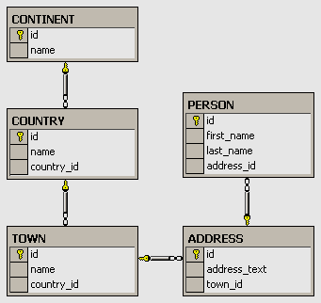
Exercises
Create the following database diagram in SQL Server:
Fill some sample data in the tables with SQL Server Management Studio.

Slide 147
Exercises (2)
Typical universities have: faculties, departments, professors, students, courses, etc. Faculties have name and could have several departments. Each department has name, professors and courses. Each professor has name, a set of titles (Ph. D, academician, senior assistant, etc.) and a set of courses. Each course consists of several students. Each student belongs to some faculty and to several of the courses. Your task is to create a data model (E/R diagram) for the typical university using SQL Server Management Studio.

Slide 148
Exercises (3)
We should design a multilingual dictionary. We have a set of words in the dictionary. Each word can be in some language and can have synonyms and explanations in the same language and translation words and explanations in several other languages. The synonyms and translation words are sets of words from the dictionary. The explanations are textual descriptions. Design a database schema (a set of tables and relationships) to store the dictionary.

Slide 149
Exercises (4)
Add support in the previous database for storing antonym pairs.
Add support for storing part-of-speech information (e.g. verb, noun, adjective, …).
Add support for storing hypernym / hyponym chains (e.g. tree → oak, pine, walnut-tree, …).

Slide 150
Exercises
What is SQL? What is DML? What is DDL? Recite the most important SQL commands.
What is Transact-SQL (T-SQL)?
Start SQL Management Studio and connect to the database TelerikAcademy. Examine the major tables in the TelerikAcademy schema.
Write a SQL query to find all information about all departments.
Write a SQL query to find all department names.
Write a SQL query to find the salary of each employee.

Slide 151
Exercises (2)
Write a SQL to find the full name of each employee.
Write a SQL query to find the email addresses of each employee (by his first and last name). Consider that the mail domain is telerik.com. Emails should look like “John.Doe@telerik.com". The produced column should be named "Full Email Addresses".
Write a SQL query to find all different employee salaries.
Write a SQL query to find all information about the employees whose job title is “Sales Representative“.
Write a SQL query to find the names of all employees whose first name starts with "SA".

Slide 152
Exercise (3)
Write a SQL query to find the names of all employees whose last name contains "ei".
Write a SQL query to find the salary of all employees whose salary is in the range [20000…30000].
Write a SQL query to find the names of all employees whose salary is 25000, 14000, 12500 or 23600.
Write a SQL query to find all employees that do not have manager.
Write a SQL query to find all employees that have salary more than 50000. Order them in decreasing order by salary.

Slide 153
Exercise (4)
Write a SQL query to find the top 5 best paid employees.
Write a SQL query to find all employees along with their address. Use inner join with ON clause.
Write a SQL query to find all employees and their address. Use equijoins (conditions in the WHERE clause).
Write a SQL query to find all employees along with their manager.
Write a SQL query to find all employees, along with their manager and their address. Join the 3 tables: Employees e, Employees m and Addresses a.

Slide 154
Exercise (5)
Write a SQL query to find all departments and all region names, country names and city names as a single list. Use UNION.
Write a SQL query to find all the employees and the manager for each of them along with the employees that do not have manager. User right outer join. Rewrite the query to use left outer join.
Write a SQL query to find the names of all employees from the departments "Sales" and "Finance" whose hire year is between 1995 and 2000.

